Slide 1
Predicting Human Activities from Smart Devices
Student: Thi (Kimhong) Dinh
Tools: Python, Pandas, Numpy, Bokeh, AWS, Scikit-Learn, Keras
Duration: 3 weeks

Slide 2
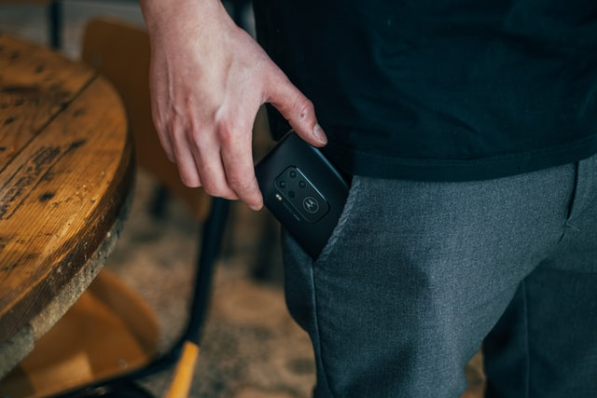
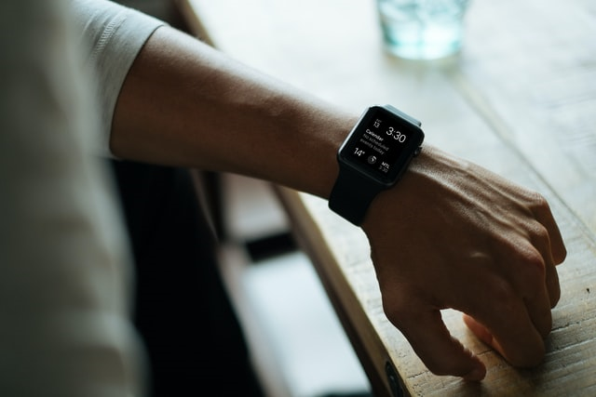
Data Overview
Data was collected by the members of the WIDSM (Wireless Sensor Data Mining) Lab in the Department of Computer and Information Science of Fordham University
2 sensors: Accelerometer and Gyroscope
(*) The data set is available from the UCI Machine Learning Repository as the “WISDM Smartphone and Smartwatch Activty and Biometrics Dataset.”
(*) Photos are from https://unsplash.com/ and for illustration only.
(*) The smartphone used in this project are Google Nexus 5/5x or Samsung Galaxy S5 and smart watch used is LG G Watch
Thanks you Department of Computer and Information Science of Fordham University
for data contribution

Slide 3

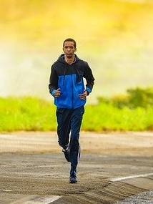
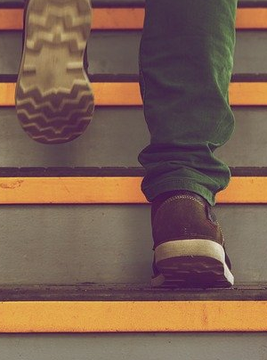


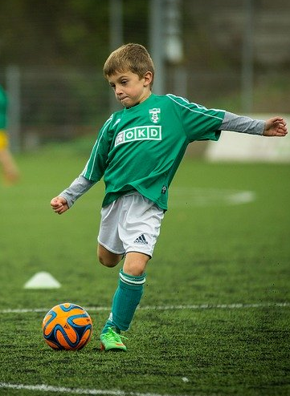

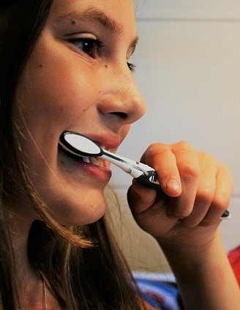

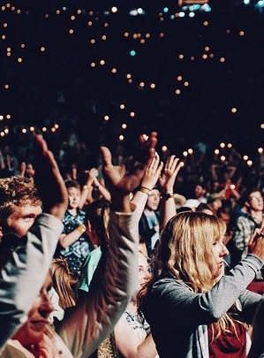
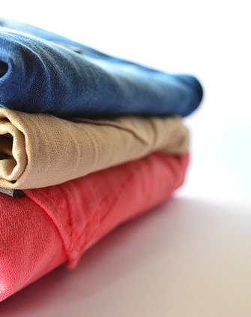
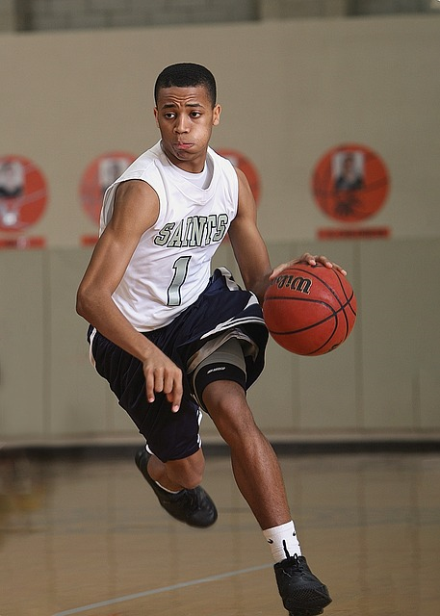
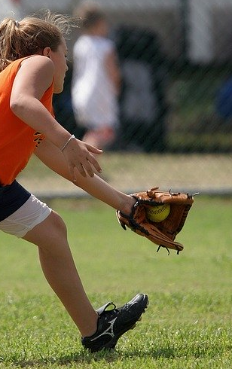
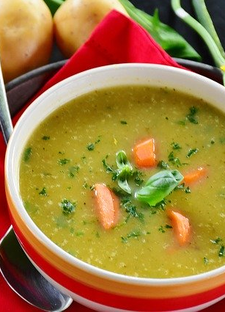
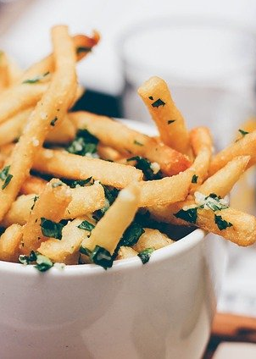
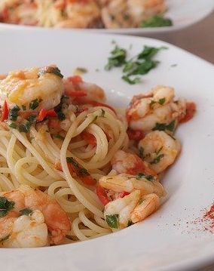
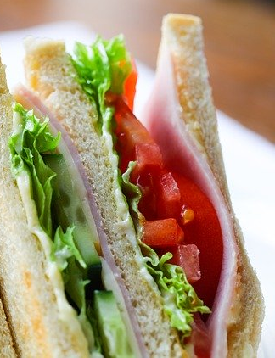

Walking
Jogging
Climbing stairs
Sitting
Standing
Kicking a ball
18 activities
Typing
Brushing teeth
Writing
Clapping
Folding clothes
Dribbling
(Basket ball)
Playing catch
w/Tennis Ball
Eating soup
Eating chips
Eating Pasta
Eating sandwich
Drinking from cup
(*)Photos from https://pixabay.com/

Slide 4
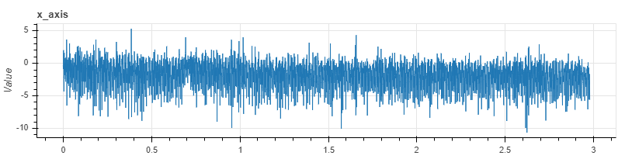
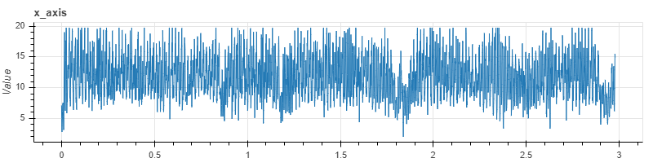
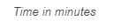
Time Series Classification
Approach 1 – Using a traditional classifier on label data from a fixed length window at 10 seconds
Phone data
Mean, std, skewness, correlation, cosine distance
Watch data

Slide 5
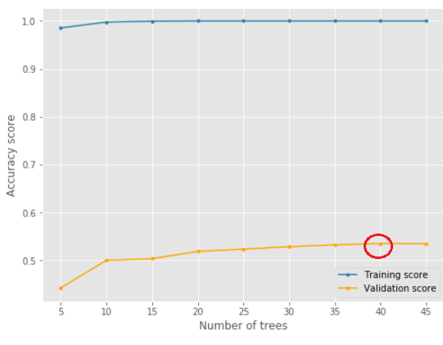
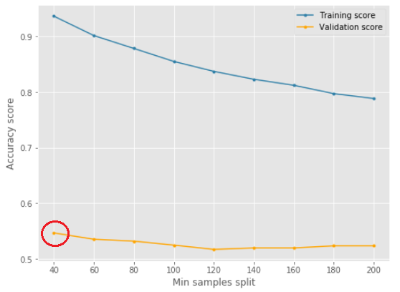
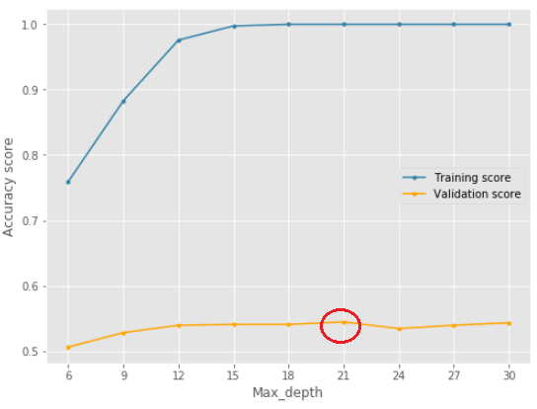
Model | Accuracy score on training set | Accuracy score on test set
KNN | 86.47% | 48.73%
Decision Tree | 100% | 50.19%
Random Forest | 100% | 66.65%
Adaboost | 25.12% | 23.18%
Bagging | 100% | 63.63%
Voting | 97.27% | 46.66%
After optimizing hyperparameters in Random Forest model, accuracy score in training set is 92.89% and test set is 65.82%

Slide 6
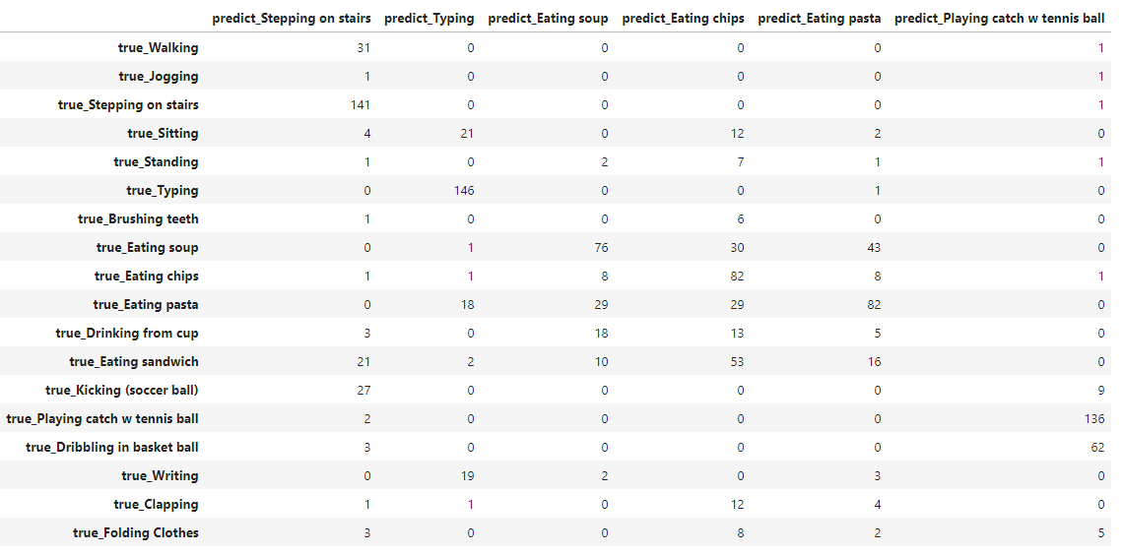
Approach 1 – Confusion matrix in some highlight activities from Random Forest Model

Slide 7
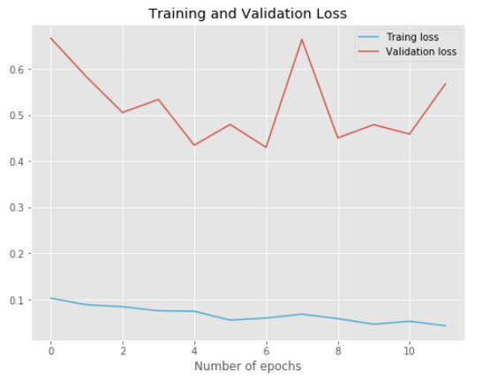
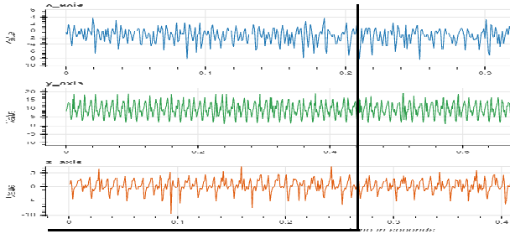
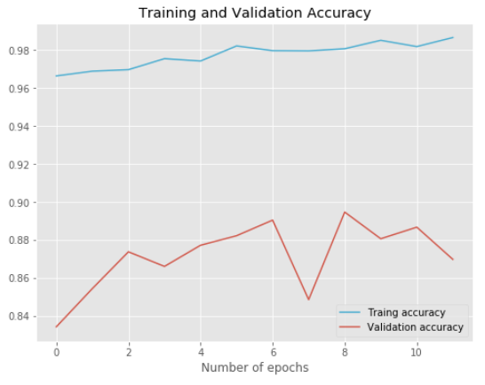
Approach 2 – 1D Convolutional Neural Network
Training accuracy: 94.71%
Test accuracy: 63.71%
Phone accelerometer
Phone gyroscope
Watch accelerometer
Watch gyroscope
Input layer (200,3)
Input layer (200,3)
Input layer (200,3)
Input layer (200,3)
Conv1D
Conv1D
Conv1D
Conv1D
MaxPooling1D
MaxPooling1D
MaxPooling1D
MaxPooling1D
…
…
…
…
Flatten
Flatten
Flatten
Flatten
Concatenate
Batch Normalization
Dense
…
Output (probability of 18 activities)
Summary of model architecture
No. of layers in each input |  |  |  | General layer |  |  | Optimization Hyperparameters |  | Callback
Input layer | Conv1D | MaxPooling1D | Flatten | Concatenate | Batch Normalization | Dense | No. of epochs | Optimizer | Early Stopping
1 | 4 | 4 | 1 | 1 | 1 | 4 | 20 | Adam | monitor='val_loss', patience=5

Slide 8
Summary
Without model, random chance to predict correct activity is 5.56%
Accuracy from my best model: Random Forest - 65.82%
Future work:
- Apply Recurrent Neural Network to improve model’s performance
- Combine all eating activities into 1 to improve accuracy
* Build 1 more separate model to predict who is performing activity

Slide 9
Thank you!
Email: hong.dinhthikim@gmail.com
LinkedIn: https://www.linkedin.com/in/thi-kimhong-dinh/
GitHub: https://github.com/dinhkimhong

